Slide 1
ME 366 Lungs Performance Analysis Using Spirometry
A18
Submitted By: 1710007 1710010 1710023
Bangladesh University of Engineering and Technology

Slide 2
Spirometry & Uses
Spirometry is a test to measure the volume of exhaled air
The Value that we are concerned in this project is "Forced Vital Capacity"
Forced vital capacity (FVC) is the maximum amount of air forcefully exhaled from the lungs
Forced Vital Capacity (FVC) depends on age, gender, race among many other criteria.
According to CDC (Central of Disease Control, USA), spirometry should be used as a precaution by the patients suffering covid

Slide 3
Overview
Build a Orifice flow meter
differential Pressure Sensor
Transfer Voltage to Pressure Difference
Use Bernoulli's Equation to calculate Volume Flow Rate
Use machine Learning algorithm to Judge lungs' Performance.
Integrate Volume Flow Rate over time

Slide 4
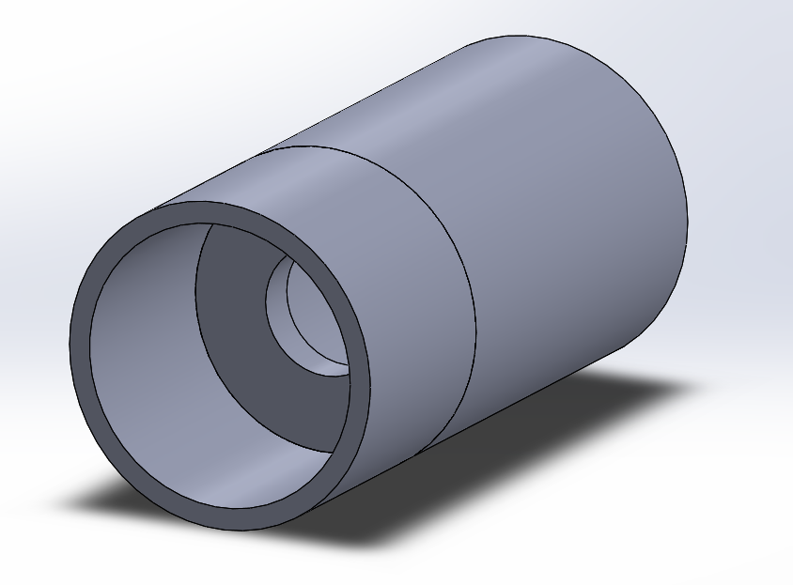
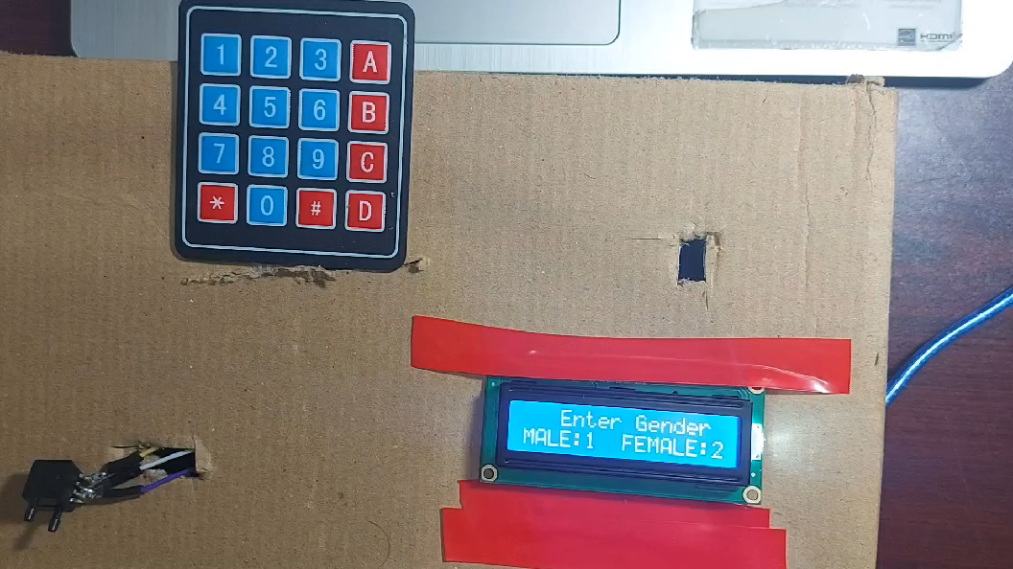
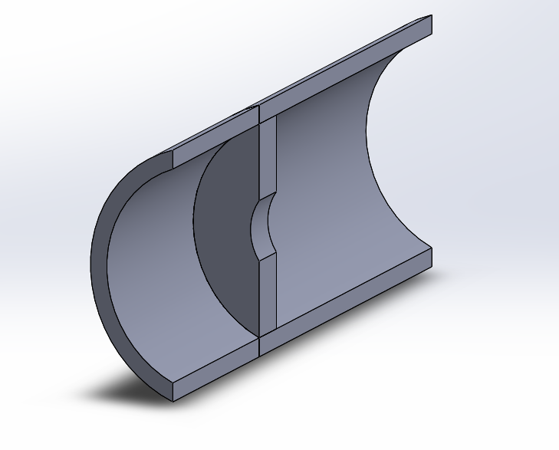
Project Demonstration
Figure: Mouthpiece
Bangladesh University of Engineering and Technology

Slide 5
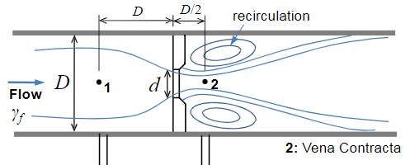
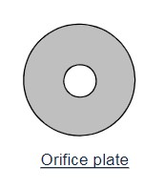

Orifice Meter
Bernoulli's Equation: $$\frac{p_{1}}{γ_{f}}+\frac{V_{1}^{2}}{2g}+z_{1}=\frac{p_{2}}{γ_{f}}+\frac{V_{2}^{2}}{2g}+z_{2}$$
By applying this Equation for orifice meter:$Q=\frac{A_{o}}{\sqrt{\left(1−\frac{d^{4}}{D^{4}}\right)}}\sqrt{(2\left(p_{1}−p_{2}\right)}/ρ_{f})$
Bangladesh University of Engineering and Technology

Slide 6
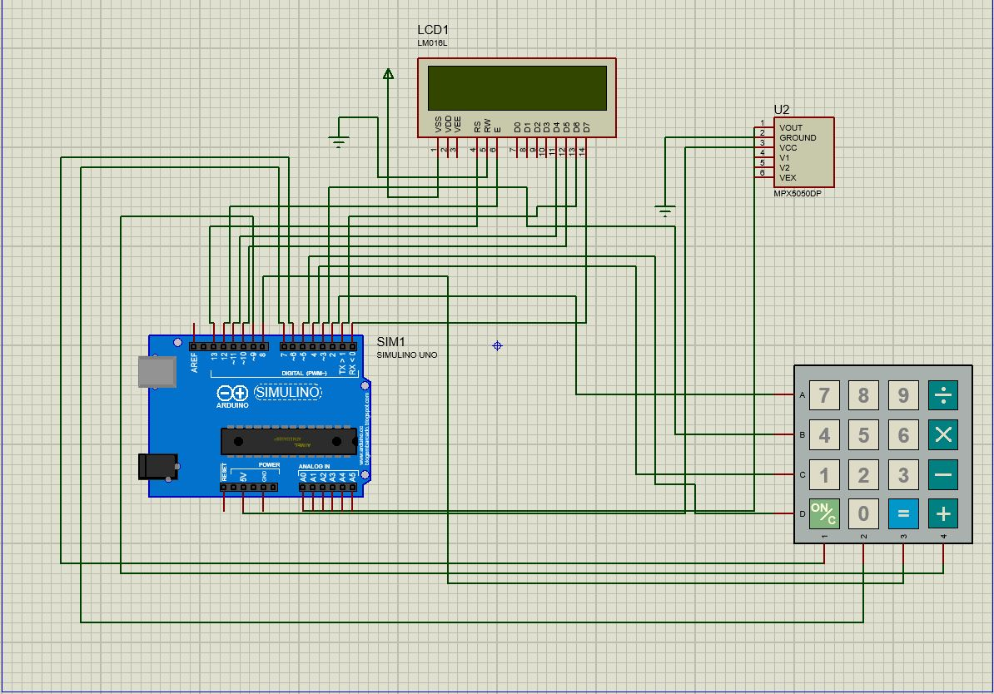
Circuit Diagram
Components :
Arduino uno
LCD display
Keypad
MPXV5050DP sensor, A differential Pressure Sensor
Proteus Simulation
Bangladesh University of Engineering and Technology

Slide 7
System Flow Chart:
Start
Input from user
Input from sensor
Calculation
Show result
Stop
Data from trained model
Bangladesh University of Engineering and Technology

Slide 8
Calculation
Calculation of FVC from sensor data
Notation :
ρ= Density of air, 1.225 (kg/m³)
P= Differential pressure (Pa)
D = diameter of the pipe (m)
d = diameter of the orifice(m)
B = d/D
V_{p}= voltage output of sensor pin (v)
A_{o} = Area of orifice (m²)
FVC = Forced vital capacity (ml)
Q= Volume flow rate (ml³/s)
S=Data sampling time, 0.01s
V = V_{p} ×5/1024
Transfer equation: P=(V/5-.04)×1000/0.018
Q = (A_{o} ×((2 ×P / ρ)^{0.5})/((1-B⁴)^{0.5}) ) ×10⁶
Loop till Q is greater than a trigger value:
FVC=FVC+Q× S
Bangladesh University of Engineering and Technology

Slide 9
Calculation: Calculation of Lung performance using Trained Model
Coefficients of trained model : M=
Data taken from user : X=
Lung performance :
Y=MX'
[-67.497798082503 | 0.0237200392 | 0.617981660 | 29.6510904 | 2.23838912]
[ 1 | FVC | Age | Gender | Smoking status]
Y(Lungs Performance) | Remarks
80% or greater | Normal
Less than 80% | Weak
Source: American Thoracic Society
Bangladesh University of Engineering and Technology

Slide 10
Lung Performance Dependency
Age
Lung Functions Decreases Slightly each year with age
Gender
Adult Female lungs is typically 10-12% smaller than males of same height and weight
Height
Lung Performance is Proportional to body size
Weight
Changes with different ranges of weight and height(BMI)
Ethnicity
Plays a fundamental role, but not sufficient data to differentiate between all races
Physical Activities
Lungs works better for people who exercise regular
Source: Archivos de Bronconeumologia
Bangladesh University of Engineering and Technology

Slide 11
Data Availability
Test Subjects
Features
Total Subjects: 1549
Age: Between 18 to 88
Train data: 0.9*1549 = 1394
Test data: 0.1*1549 = 155
Gender
Age
Smoking Status
FVC(Forced Vital Capacity)
Male: 1224
Female: 325
Ex-smoker
Never smoked
Currently smokes
Source: Kaggle
Bangladesh University of Engineering and Technology

Slide 12
Model Training (Language Used: Python)
Preparing Data
Data Read
Data Cleaning
Linear Regression Model Training
Trained Matrix
Data Input
Selecting Needed Features
Conversion: String to Numerical Values
Bangladesh University of Engineering and Technology

Slide 13
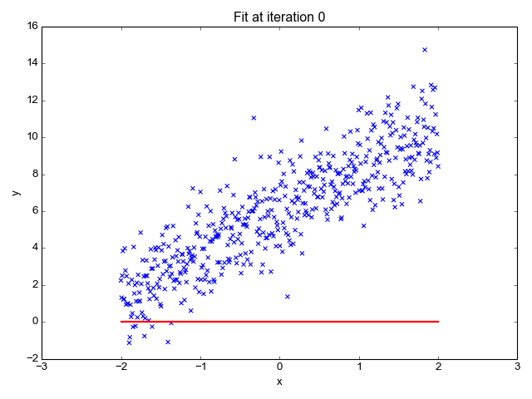
Linear Regression Model
Equation of Straight Line:
Y= mx + b
Multiple Linear Regression
y = b₀ + m₁b₁ + m₂b₂ + ... m_{n}b_{n}
- Hyperplane
Least Square Method: The sum of the offsets or residuals of points from the plotted curve
Gradient Descent: An iterative method to analyze all weights with regard to small changes in error
Accuracy: 85-90%
Source: Toward Data Science
Bangladesh University of Engineering and Technology

Slide 14
Cost Analysis
Electrical Components | Price
Arduino Uno | TK. 700
10k Potentiometer | TK. 50
16x2 LCD Display | TK. 160
MPXV5050DP Sensor | TK. 2500
Jumper Wires | TK. 60
Matrix Key Pad (3x4) | TK. 90
Lodestar Soldering Iron | TK. 322
Solder Lead Mini | TK. 49
Total Cost | TK. 3931
Source: Techshop bd
Bangladesh University of Engineering and Technology

Slide 15
Problems We Faced
The obstacles we encountered during the project:
1. Calibration.
2. Unavailability Of Components
3. Unavailability Of Sufficient Dataset : Total Patient, Features.
Bangladesh University of Engineering and Technology

Slide 16
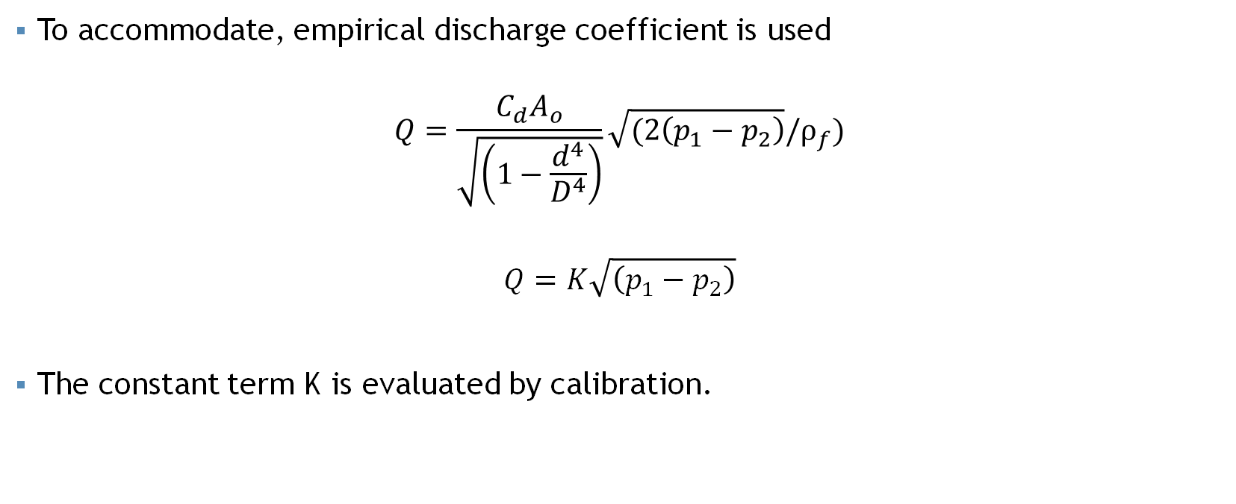
Calibration
To accommodate, empirical discharge coefficient is used
$$Q=\frac{C_{d}A_{o}}{\sqrt{\left(1−\frac{d^{4}}{D^{4}}\right)}}\sqrt{(2\left(p_{1}−p_{2}\right)}/ρ_{f})$$
$$Q=K\sqrt{\left(p_{1}−p_{2}\right)}$$
The constant term K is evaluated by calibration.
Bangladesh University of Engineering and Technology

Slide 17
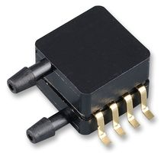
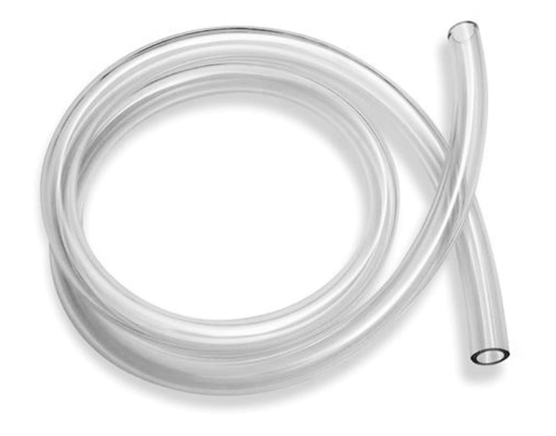
Unavailability of Components:
Due to the pandemic, we kept our search for hardware parts limited to online shopping.
We were able to find most of the electrical components. However, we could not find some hardware elements.

Slide 18
Limitations
necessity of regular calibration
Spread out of germs/bacteria/virus
Bangladesh University of Engineering and Technology

Slide 19


Thank You

